Slide 1

Sentiment Analysis
Amazon Fine Food Reviews
By: Humberto Gonzalez Granda

Slide 2
objective
Review data can be analyzed to gauge overall customer response.
Companies can position products differently or change target audience.
OBJECTIVE:
Apply the sentiment analysis process to Amazon Fine Food Reviews to be able to position the products differently or change their target audience.

Slide 3
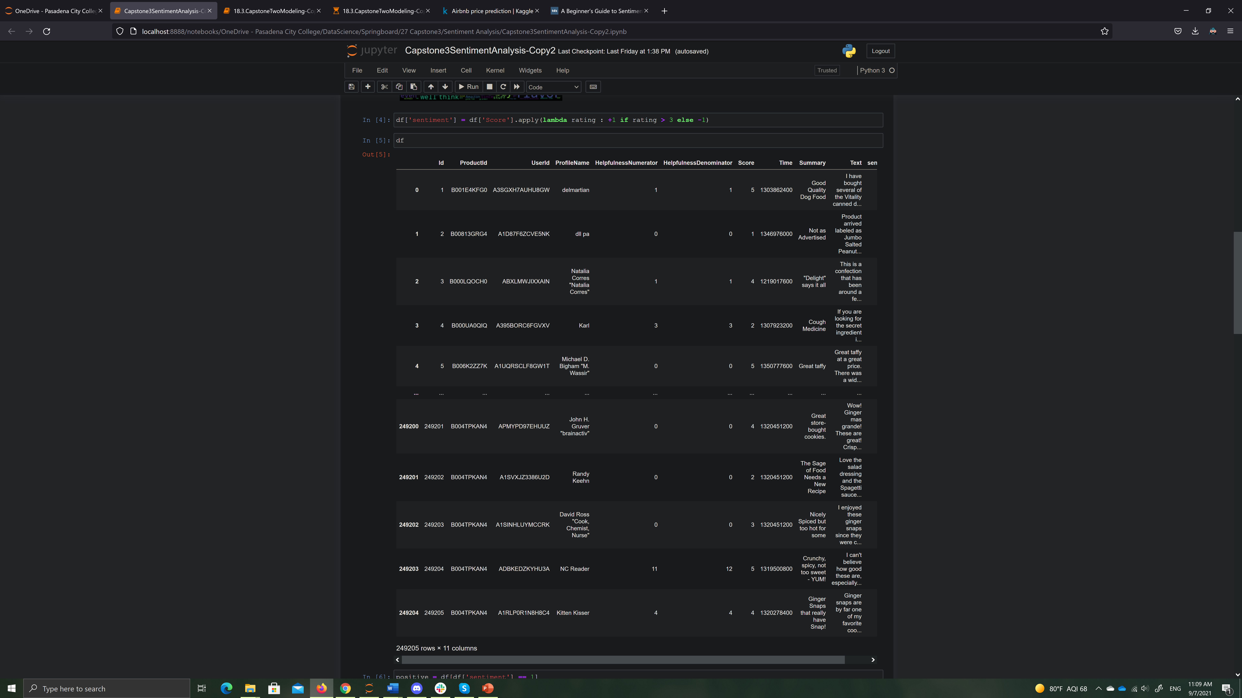
DAtaset
Reviews. csv file from Kaggle’s Amazon Fine Food Reviews.
Contains some product, user and review information.
Text: Complete product review information.
Summary: Of the entire review.
Score: Product rating by customer.

Slide 4
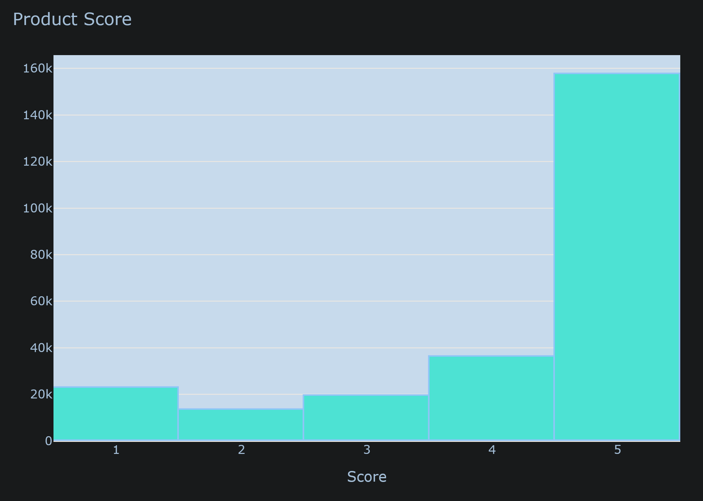
Product score plot
We can see that most of the customer rating is positive.
This leads me to believe that most reviews will be pretty positive too.
We will analyze that in a while…

Slide 5
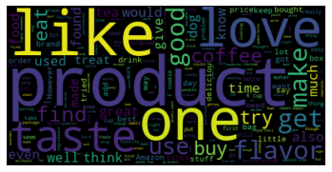
Word count
The words observed bigger are mostly positive, indicating that most reviews express a positive sentiment.

Slide 6
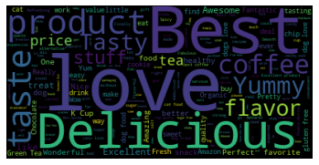
Wordcloud – positive sentiment

Slide 7
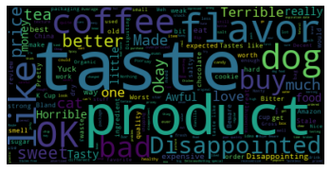
Wordcloud – negative sentiment

Slide 8
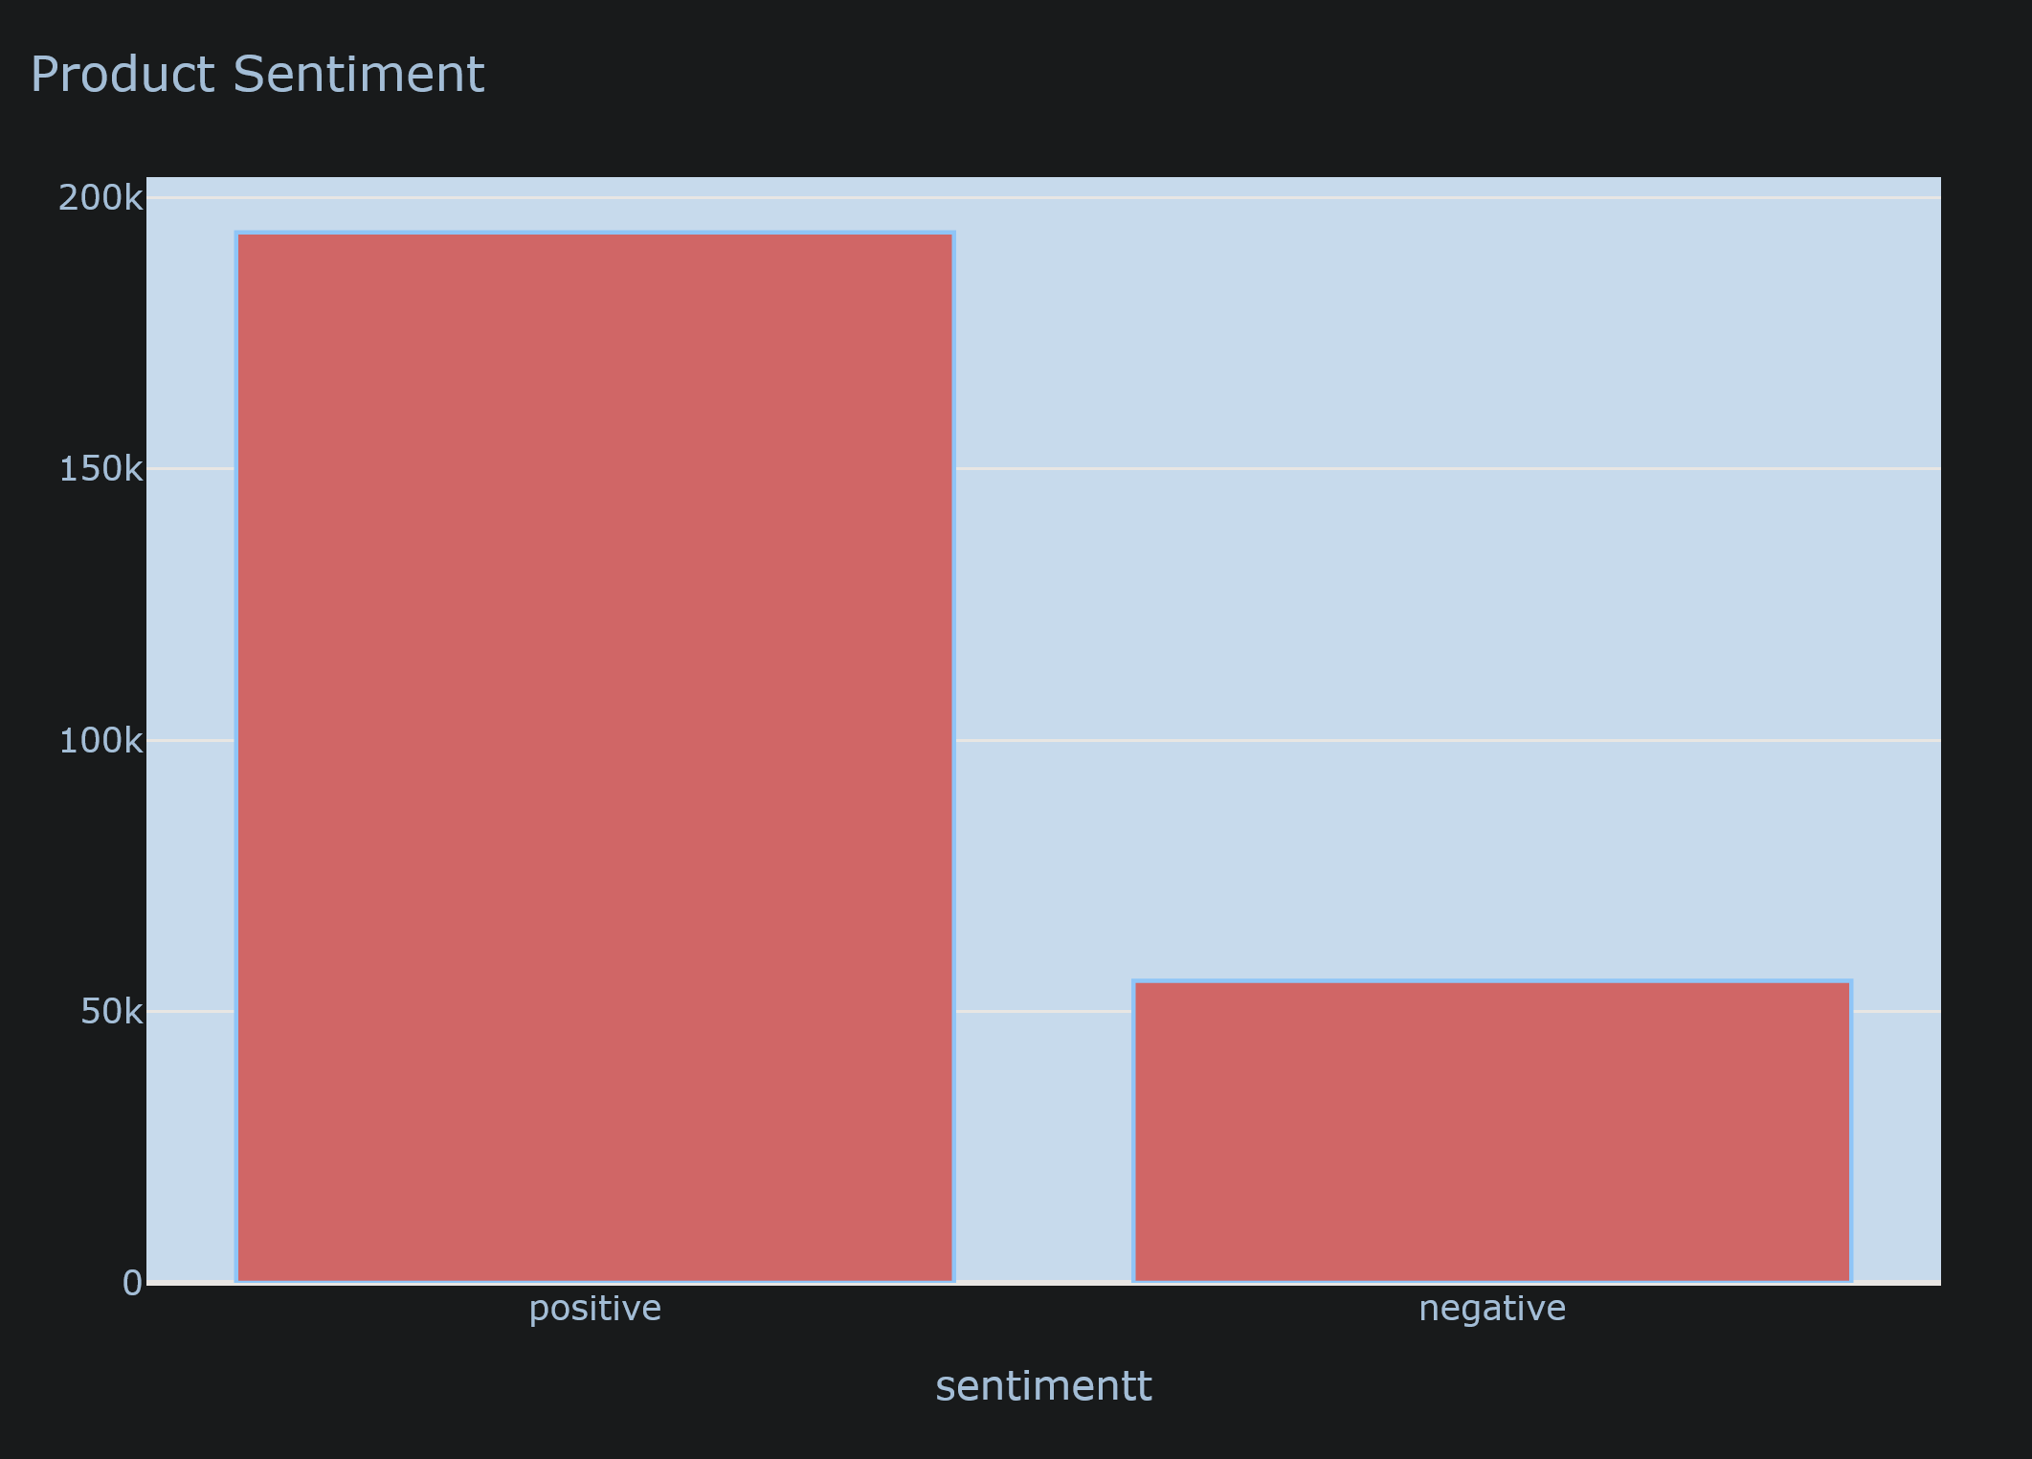
distribution of reviews with sentiment

Slide 9
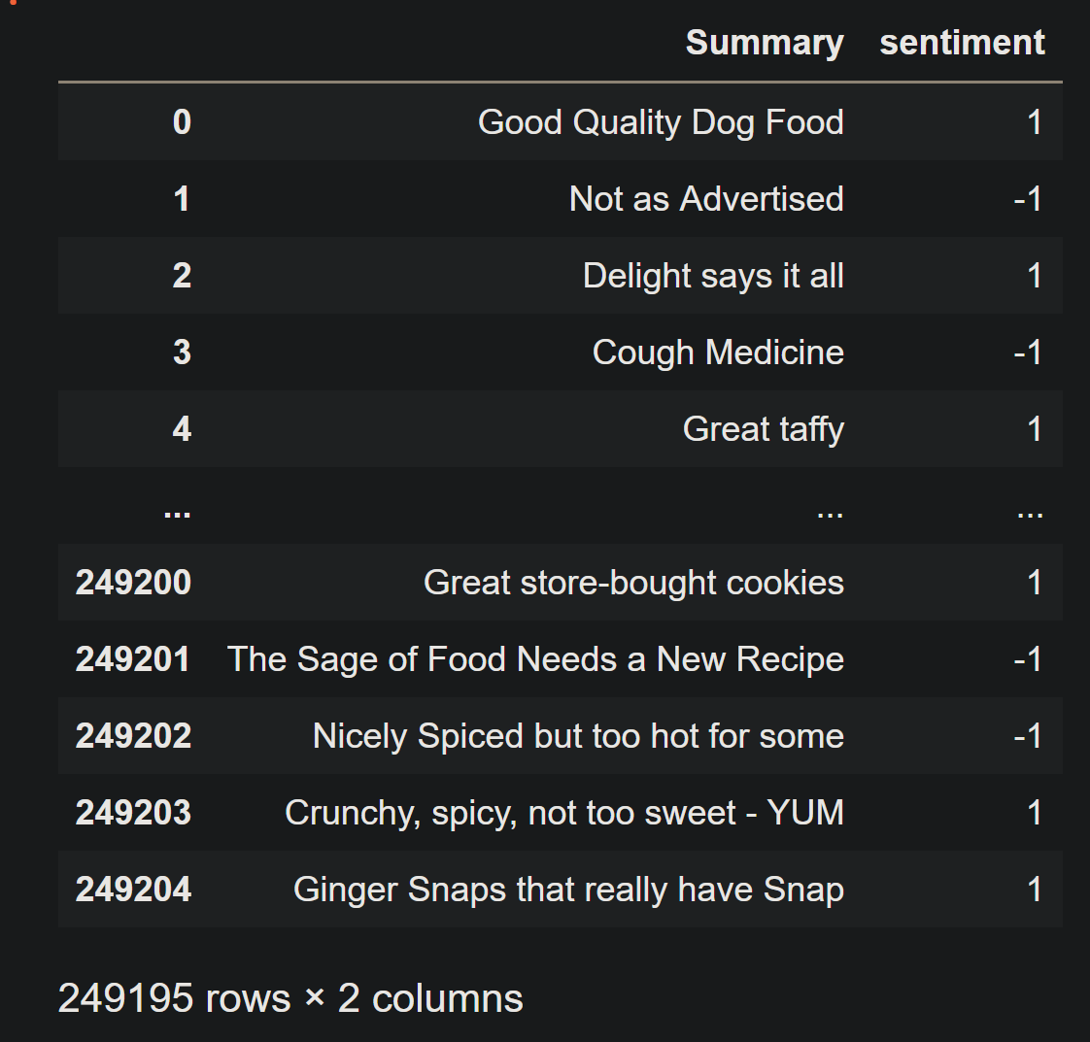
BUILDING THE MODEL
Data Cleaning
Remove all punctuation from the data
Split the Dataframe
New data frame have only 2 columns:
Summary
Sentiment

Slide 10
BUILDING THE MODEL
Create a bag of words.
Import Logistic Regression
Split target and independent variables
Fir model on data
Make predictions

Slide 11
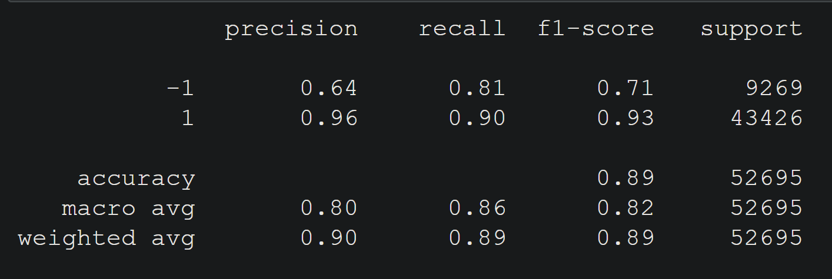
testing

